Slide 1
DRUGS FOR
DYSLIPIDEMIA

Slide 2
MAJOR LIPIDS IN OUR BODY

Slide 3
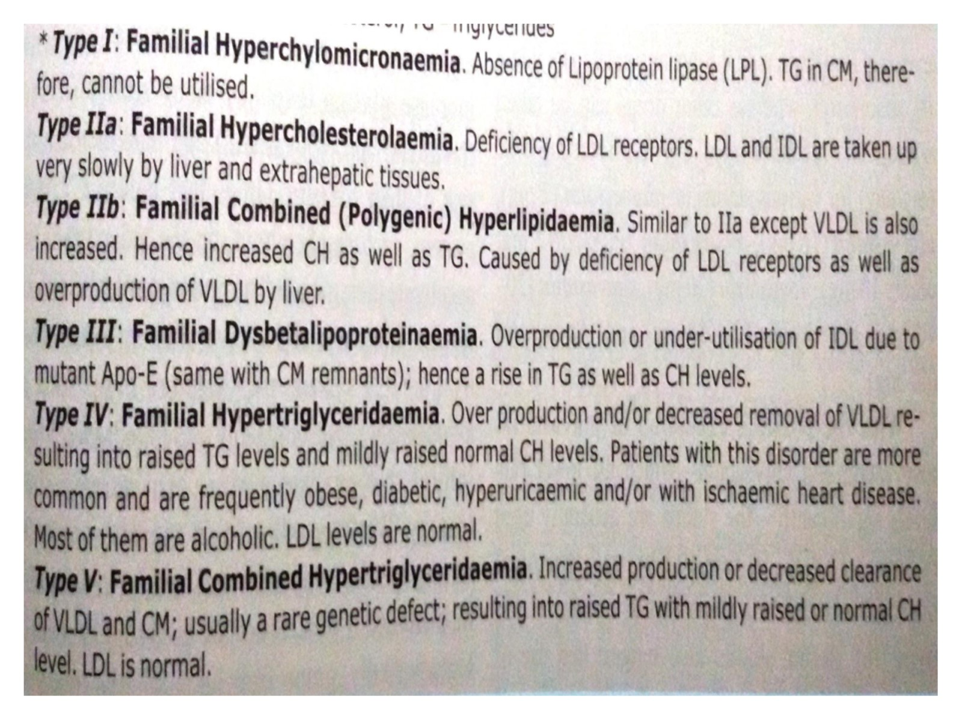

Slide 4
CHOLESTEROL

Slide 5
LIPOPROTEINS

Slide 6
TRIGLYCERIDES

Slide 7
LIPID METABOLISM

Slide 8
TARGET LEVELS FOR LIPIDS IN BLOOD

Slide 9
ATHEROSCLEROSIS

Slide 10
ATHEROSCLEROSIS

Slide 11
ATHEROSCLEROSIS

Slide 12
MONITORING THE DISEASE

Slide 13
MONITORING THE DISEASE

Slide 14
HYPOLIPIDEMICS

Slide 15
HYPOLIPIDEMICS

Slide 16
HYPOLIPIDEMICS

Slide 17
HYPOLIPIDEMICS

Slide 18
TARGETS OF DRUG ACTION

Slide 19
HMG-CoA Reductase inhibitors

Slide 20
HMG-CoA Reductase inhibitors

Slide 21
HMG-CoA Reductase inhibitors

Slide 22
HMG-CoA Reductase inhibitors

Slide 23
Bile acid binding resins

Slide 24
Bile acid binding resins

Slide 25
Intestinal cholesterol absorption inhibitors

Slide 26
Intestinal cholesterol absorption inhibitors

Slide 27
Activators of lipoprotein lipase (Fibrates)

Slide 28
Activators of lipoprotein lipase (Fibrates)

Slide 29
Activators of lipoprotein lipase (Fibrates)

Slide 30
Inhibitor of VLDL secretion and lipolysis

Slide 31
Inhibitor of VLDL secretion and lipolysis

Slide 32
Inhibitor of VLDL secretion and lipolysis

Slide 33
Newly developed Antidyslipidemics

Slide 34
Newly developed Antidyslipidemics

Slide 35
Newly developed Antidyslipidemics

Slide 36
Newly developed Antidyslipidemics

Slide 38
Newly developed Antidyslipidemics

Slide 39
HYPOLIPIDEMICS

Slide 40
HYPOLIPIDEMICS

Slide 42
COMBINATION DRUG THERAPY

Slide 43
Any Questions!!!

